Slide 1
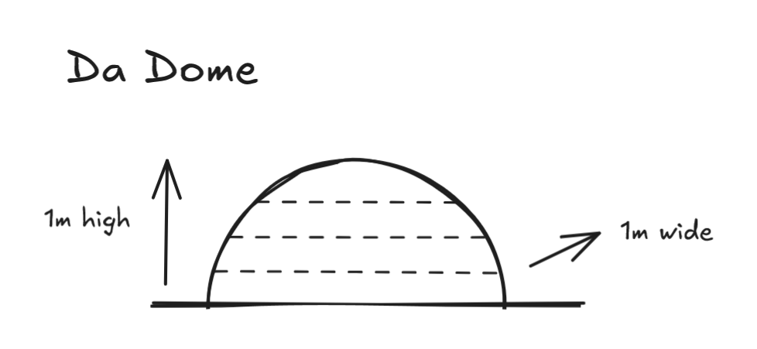

Slide 2
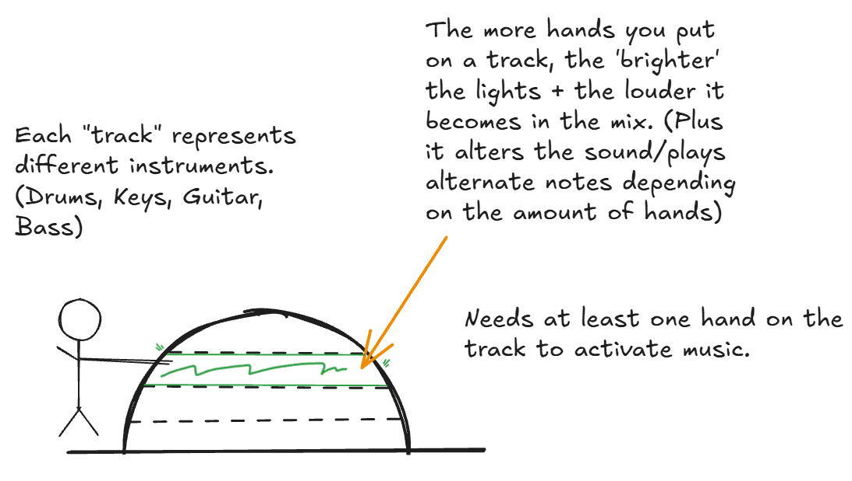
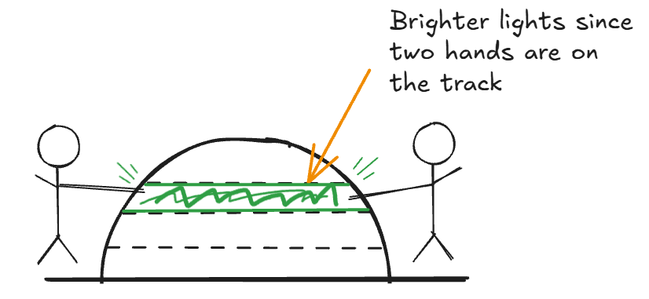

Slide 3
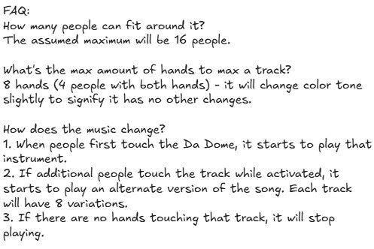

Slide 4
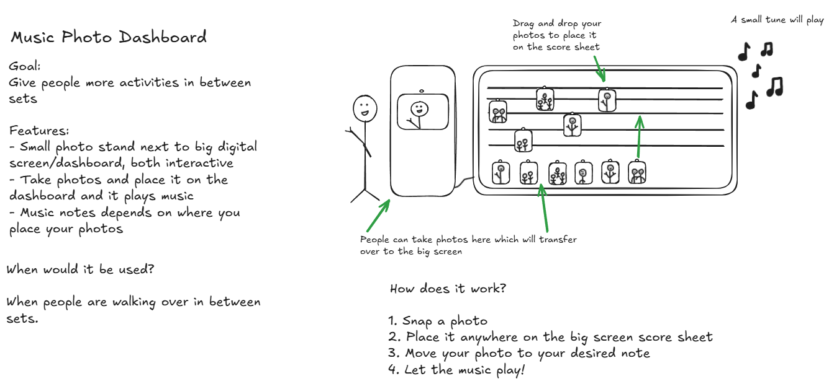
Music Photo Dashboard

Slide 6
https://excalidraw.com/#json=BPXmI2_nXY5W1oLyvaFEt,85BHact7X0WdVxNC5jaGyw

